Slide 1

Capstone Project - 1
EDA ON HOTEL BOOKING ANALYSIS BY RUSHIKESH ARJUN MANE (Cohort Seattle)

Slide 2
Contains
► INTRODUCTION
►WORK FLOW
►PROBLEM STATEMENT
►EDA (EXPLORATORY DATA ANALYSIS)
►CONCLUSION

Slide 3
INTRODUCTION
Hotel industry is a very volatile industry and the bookings depends on many factors.
The global hotel industry is a $525 Billion Dollars industry.
It become necessary and important to analyse the past data for help the hotels plan better.

Slide 4
WORK FLOW :
EDA will be divided into 3 following 3 analysis.
Univariate analysis:- It is the Simplest of the three analyses where the data you are analysing is only one variable
Bivariate analysis:- It is where you are comparing two variable to study their relationship.
Multivariate Analysis :- It is similar to Bivariate analysis but you are comparing more than two variables.
Data Collection and Understanding
Data Cleaning and Manipulation
EDA (Exploratory Data Analysis)

Slide 5
Problem Statement :
For this project we will analysing Hotel Booking data. This data set contains booking information for a city hotel and a resort hotel, and includes information such as when the booking was made , length of stay , the number of adults , children , or babies, and the number of available parking spaces.
Hotel industry is a very volatile industry and the bookings depends on above factors and many more.
The main objective behind this project is to explore and analyse data to discover important factor that govern the bookings and give insights to hotel management , which can perform various campaigns to boost the business and performance.

Slide 6
Data Collection and Understanding :
We got here the secondary data. This data contain 119390 rows and 32 columns. So its becomes important to understand the data.
Data Description:
hotel :Resort Hotel or City Hotel
is_canceled : Value indicating if the booking was canceled (1) or not (0)
lead_time : Number of days that elapsed between the entering date of the booking and the arrival date
arrival_date_year : Year of arrival date
arrival_date_month : Month of arrival date arrival_date_week_number : Week number of year for arrival date
arrival_date_day_of_month : Day of arrival date
stays_in_weekend_nights : Number of weekend nights
stays_in_week_nights : Number of week nights.

Slide 7
adults : Number of adults
children : Number of children
babies : Number of babies
meal : Type of meal booked. country : Country of origin.
country : Country of origin.
market_segment : Market segment designation. (TA/TO)
distribution_channel : Booking distribution channel.(T/A/TO) is_repeated_guest : is a repeated guest (1) or not (0)
previous_cancellations : Number of previous bookings that were cancelled by the customer prior to the current booking
previous_bookings_not_canceled : Number of previous bookings not cancelled by the customer prior to the current booking reserved_room_type : Code of room type reserved.
reserved_room_type : Code of room type reserved.

Slide 8
assigned_room_type : Code for the type of room assigned to the booking. booking_changes : Number of changes made to the booking from the moment the booking was entered on the PMS until the moment of check-in or cancellation
deposit_type : No Deposit, Non Refund , Refundable.
agent : ID of the travel agency that made the booking
company : ID of the company/entity that made the booking .
days_in_waiting_list : Number of days the booking was in the waiting list before it was confirmed to the customer
customer_type : type of customer. Contract,Group,transient,Transient party.
adr : Average Daily Rate as defined by dividing the sum of all lodging transactions by the total number of staying nights
required_car_parking_spaces : Number of car parking spaces required by the customer
total_of_special_requests : Number of special requests made by the customer (e.g. twin bed or high floor)
reservation_status : Reservation last status.

Slide 9
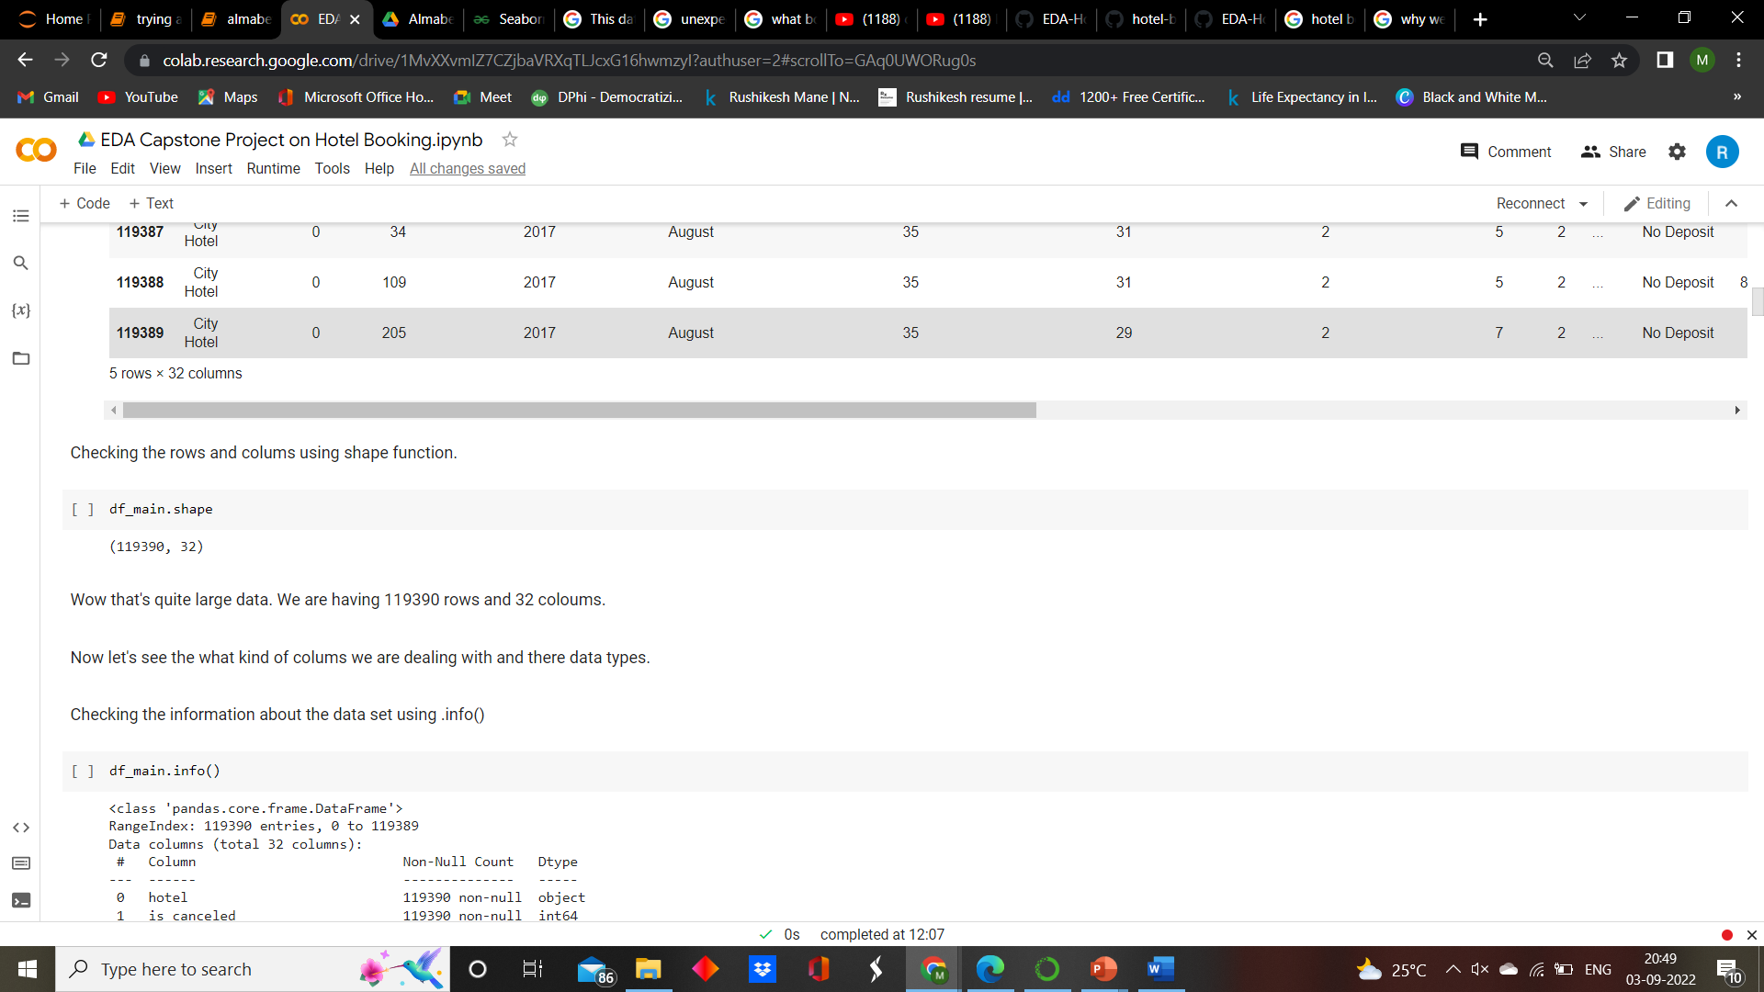
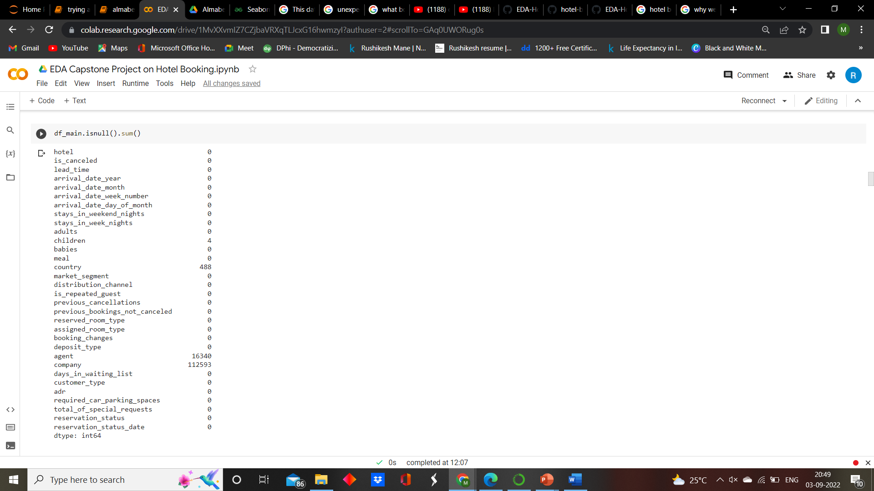
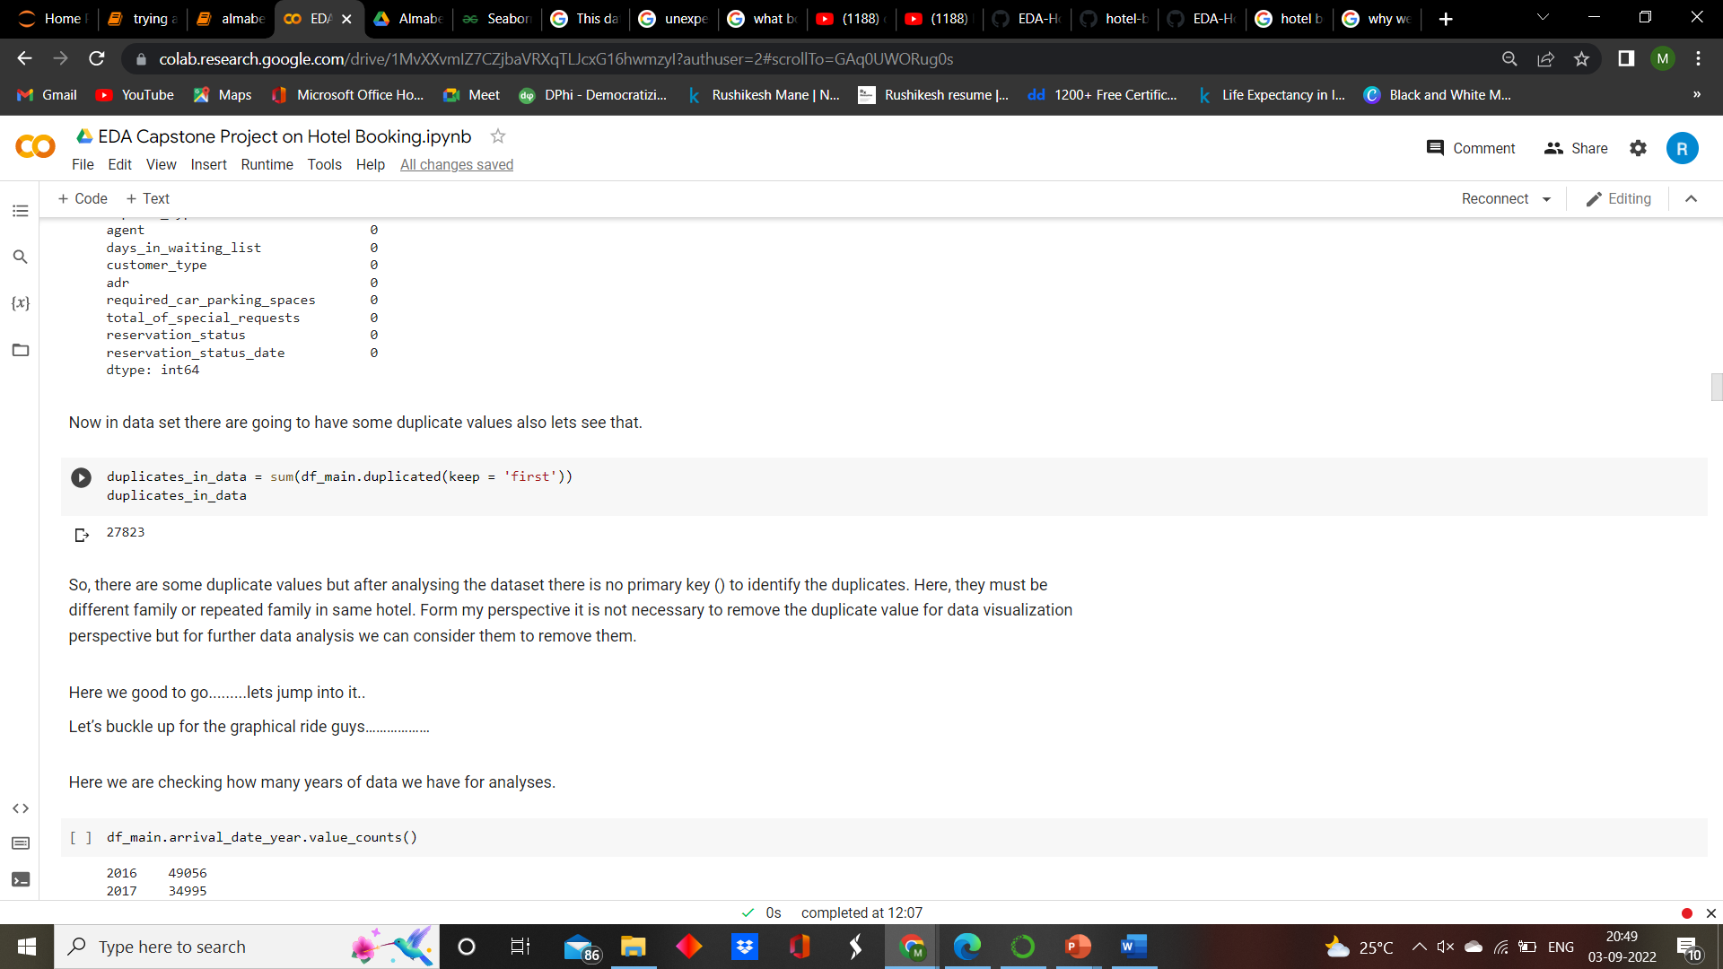
Data Cleaning and Manipulation:
After importing required library and modules for the project for data cleaning , manipulation and visualization.
Form the given data set first we will see the any missing values (null values) and duplicate value and we need to remove them.

Slide 10
EDA (Exploratory Data Analysis)
" Numbers have an important story to tell. They rely on you to give them a clear and convincing voice.“
- Stephen Few

Slide 11
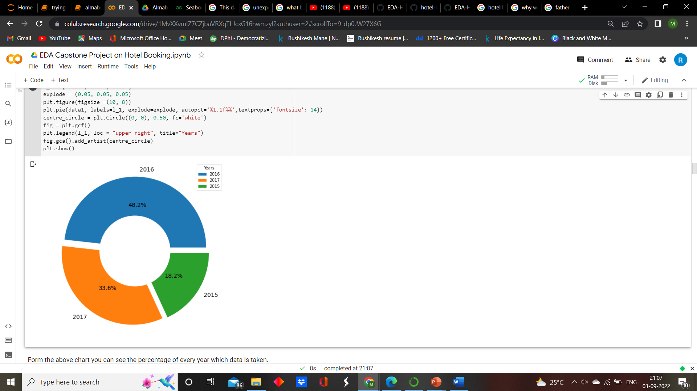
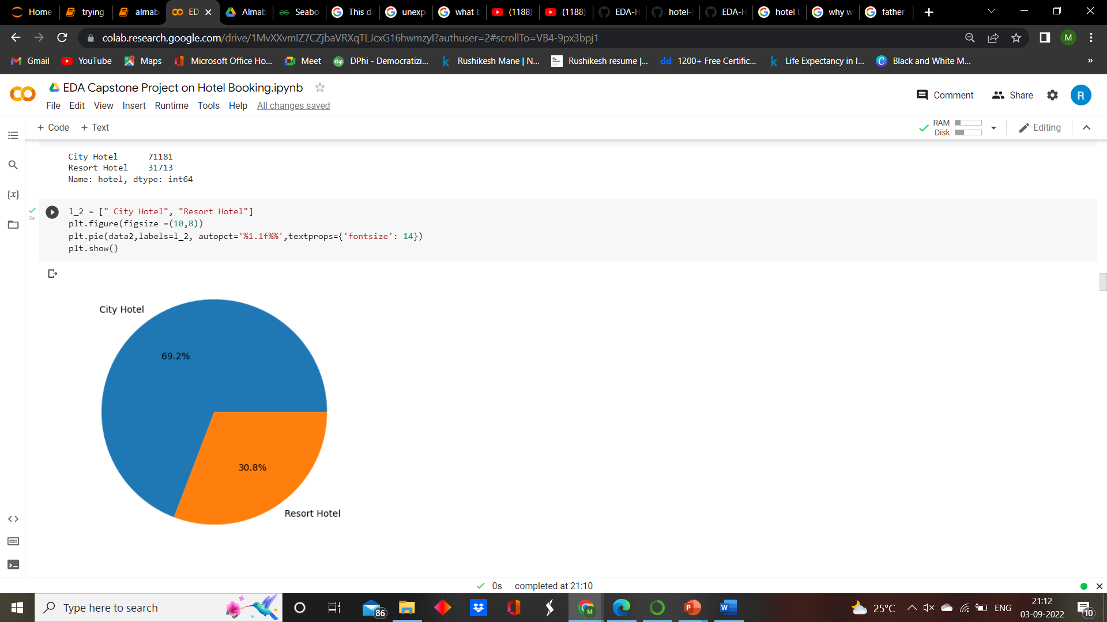
Exploring the data set,
Form the first pie chart we can see we the data set contain three years data. The maximum data is form year 2016.
Form the second pie chart we can see we have main two types of hotel i.e. City hotel and Resort Hotel. The maximum data is form City hotel i.e. 69.2% and minimum form Resort hotel i.e. 30.8%.

Slide 12
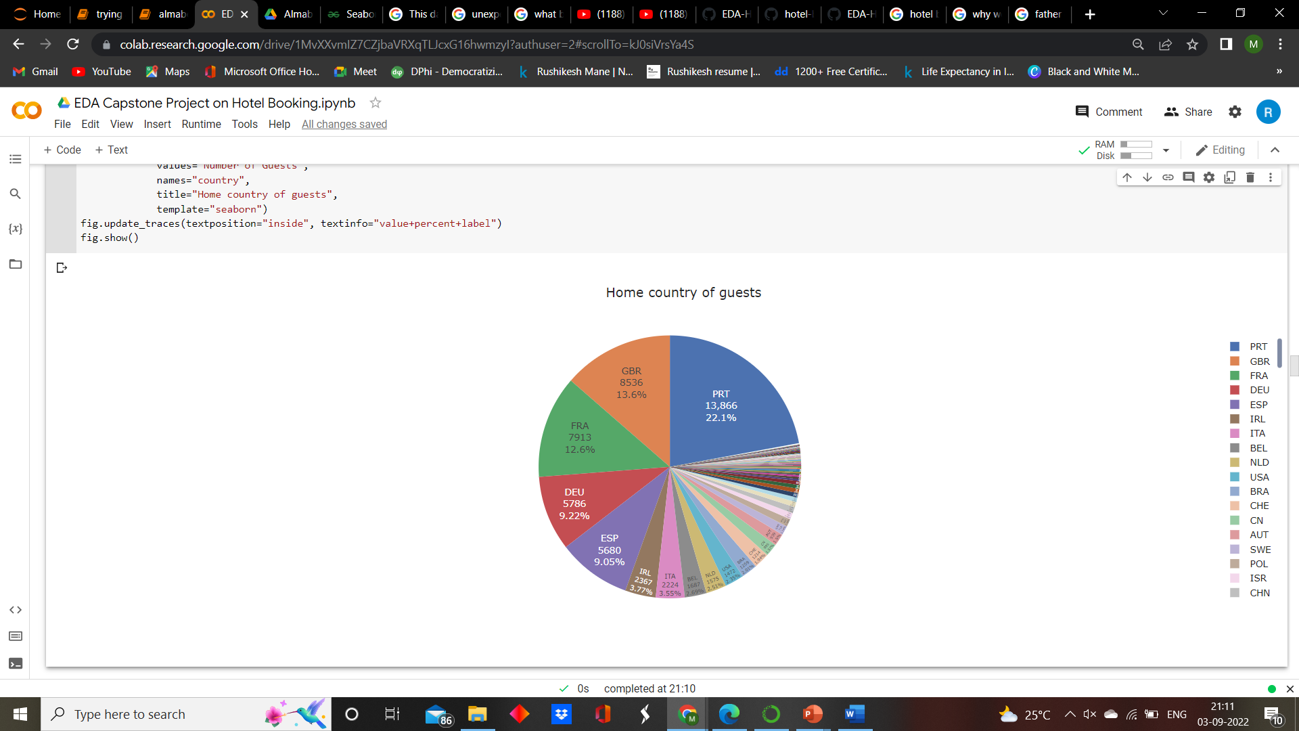
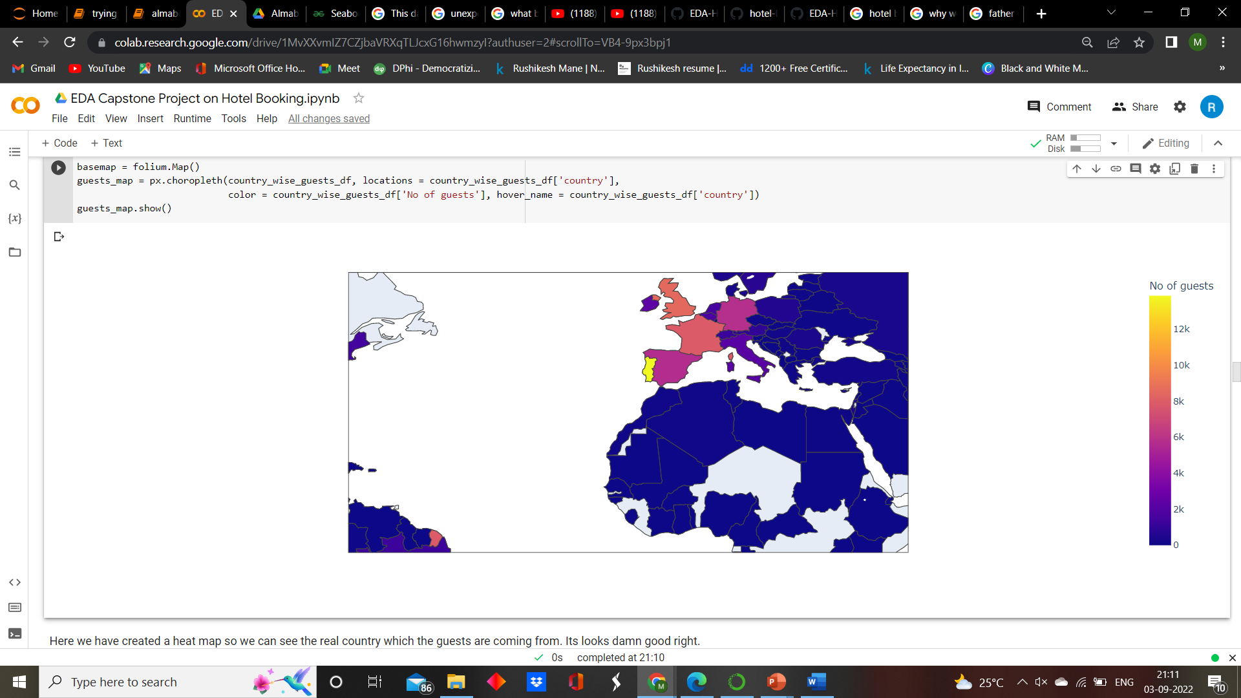
To analyze home country of guests,
Conclusion:
As we see in the above pie chart the maximum number of guests are form Portugal with 17652 guests, Great Britain with 8446 guest and France with 7104 and so on. Most tourists come from Europe since the top 5 countries are in Europe.
And in the next map we expressing the geological data in much more efficient way.

Slide 13
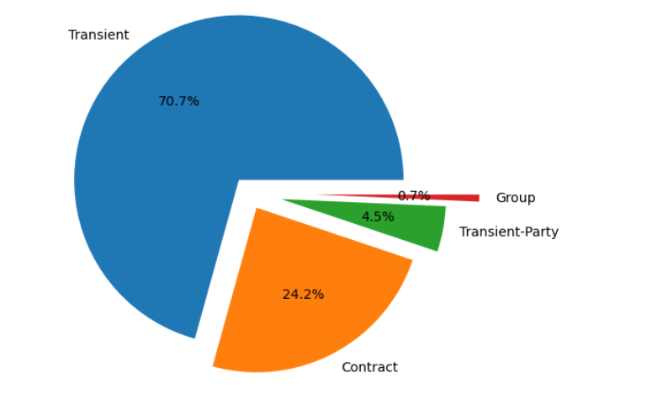
Checking the how many different types of customer are these hotels are having,
Conclusion:
From above chart we can see that 70.7 % , 24.2 %, 4.5 %, 0.7 % business are coming form transient, contract, transient-party and group respectively. And here we only considered the conform bookings.

Slide 14
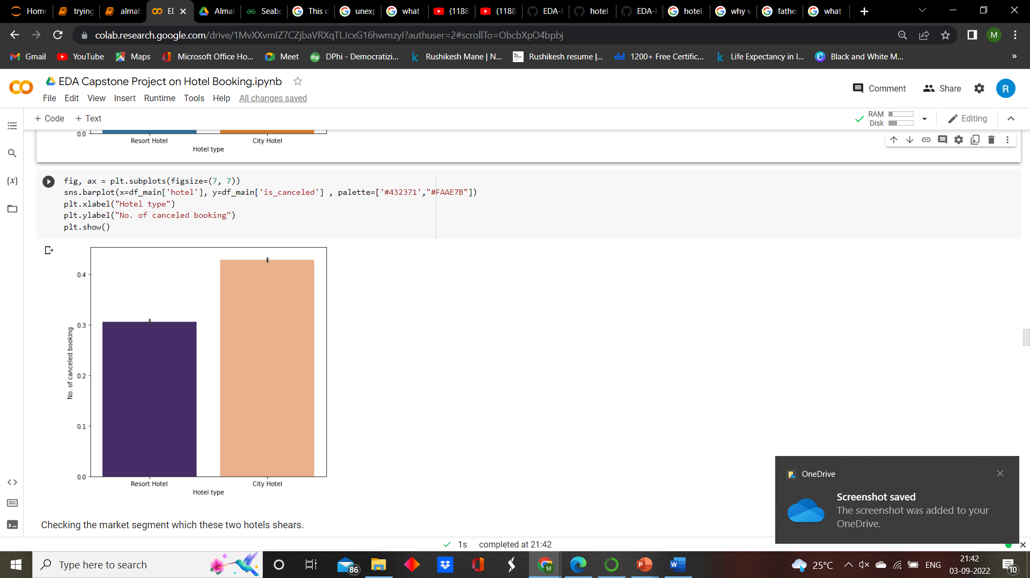
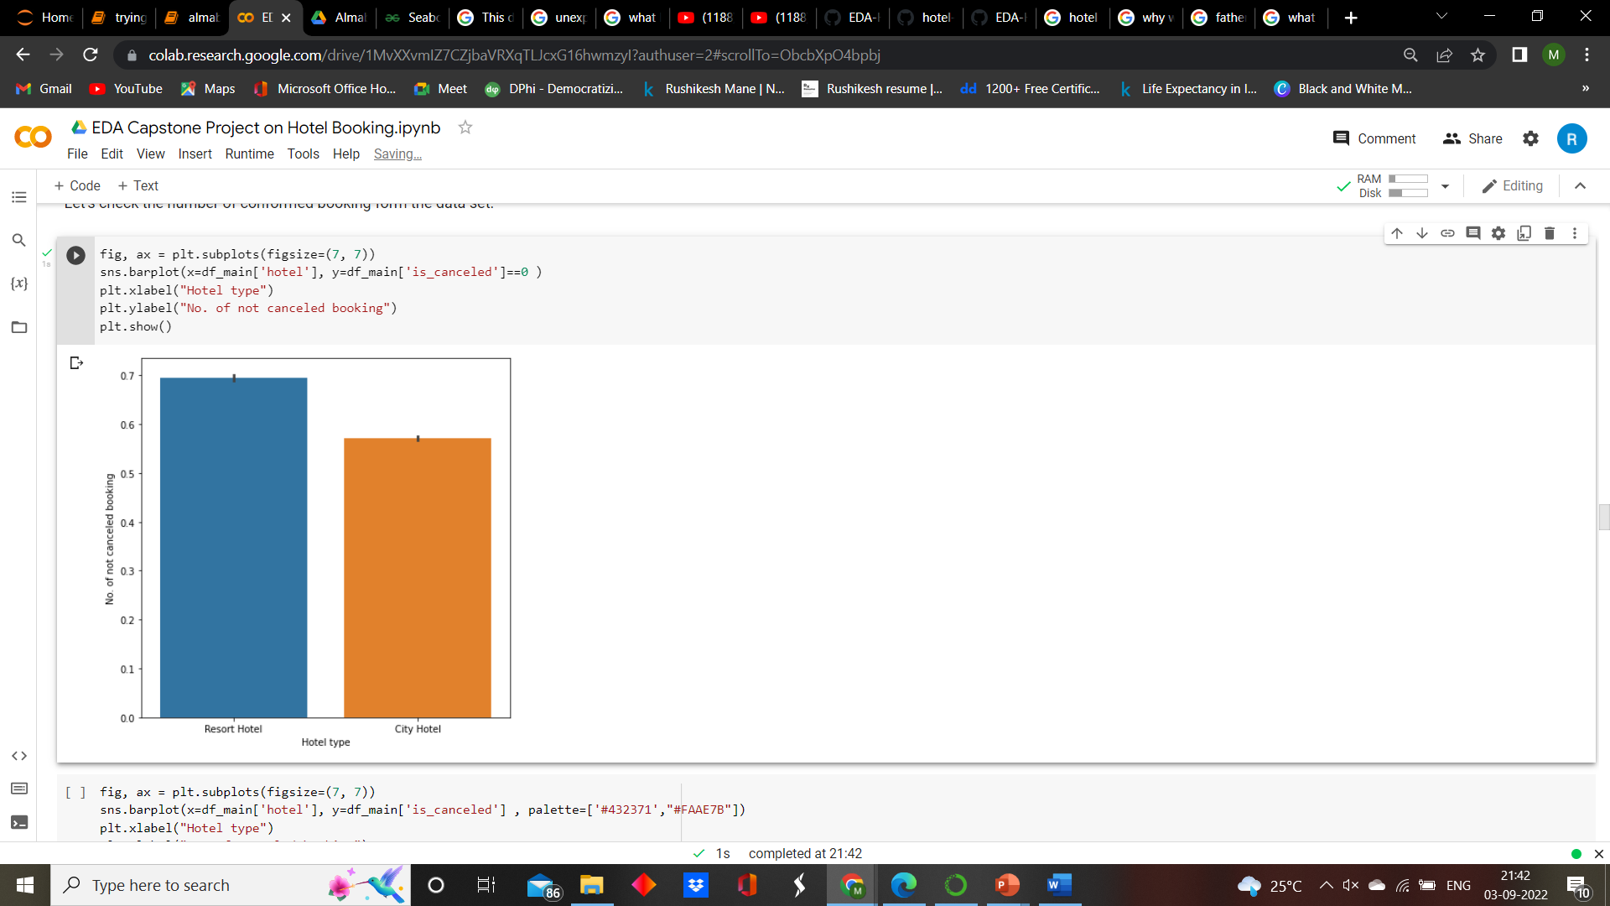
To analyze which hotel gets cancelled the most by the customers,
Observations:
Form the first bar plot we can see the maximum number of bookings are cancelled are form the City hotel that indicates people love to spend their time in peaceful Resort hotel.
Form the Second bar plot we can see the maximum number of booking not cancelled are form Resort hotel which proves our upper statement.

Slide 15
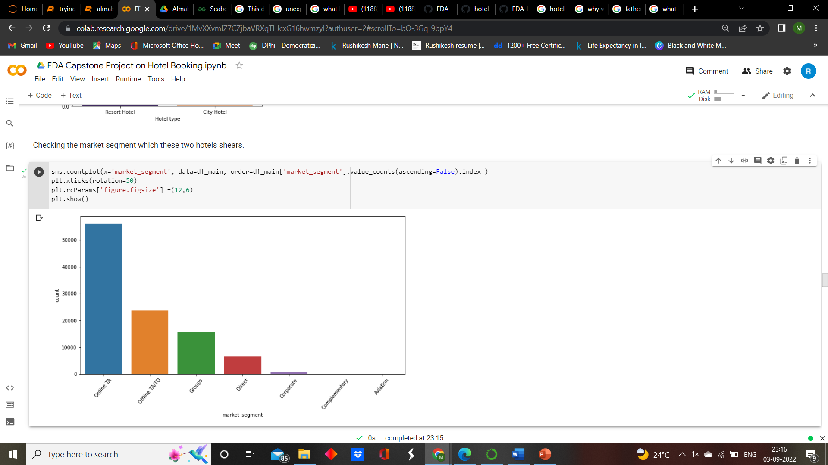
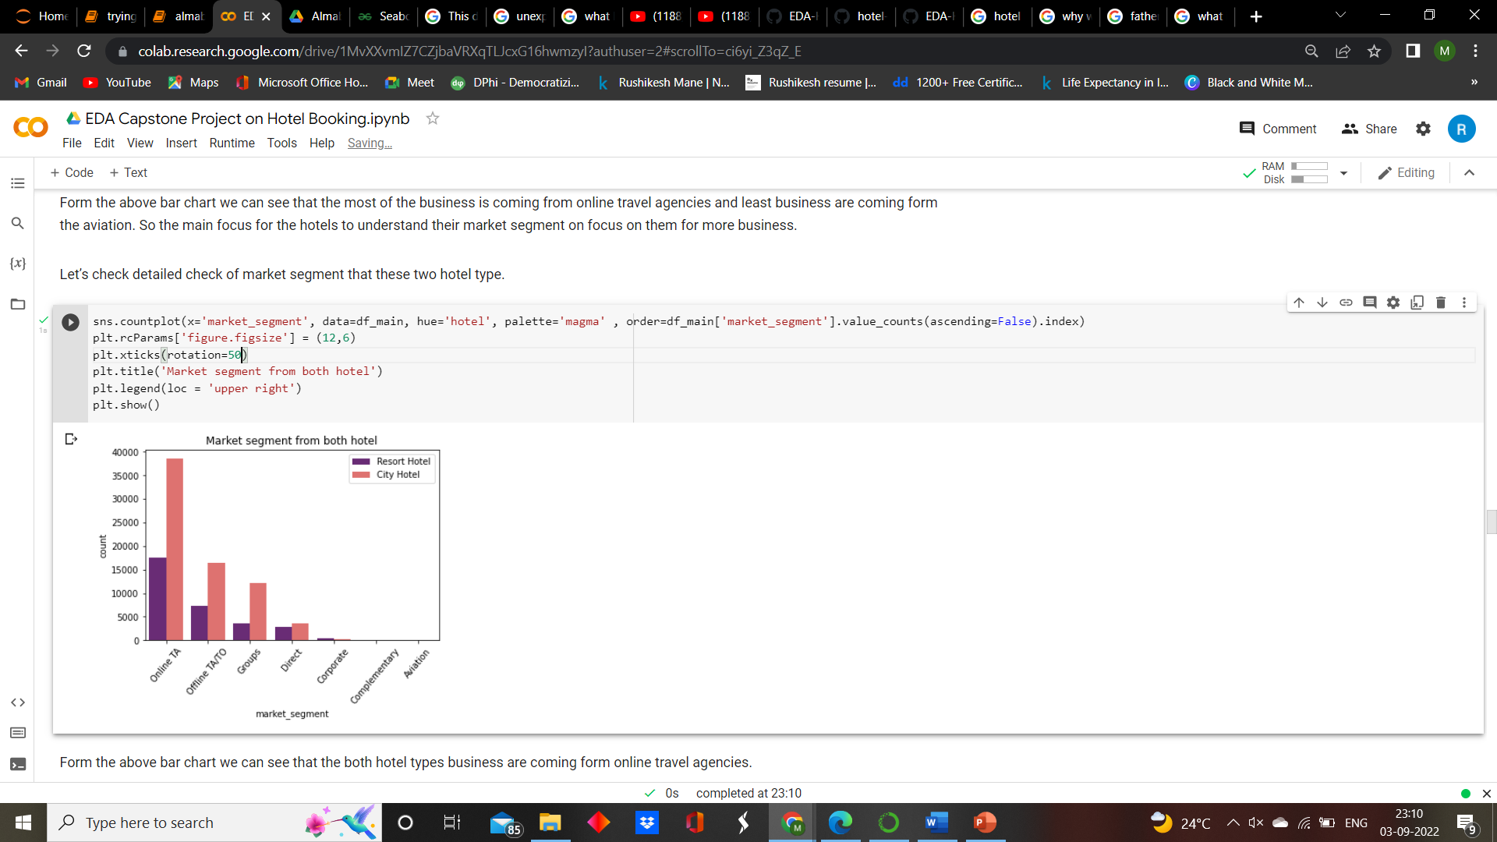
Bookings by market segment,
Observations:
From above two chart we can see that the most of the booking are done by online travel agencies which is 79.1 % and the second most segment is offline travel agencies. And the minimum bookings are coming for aviation segment.

Slide 16
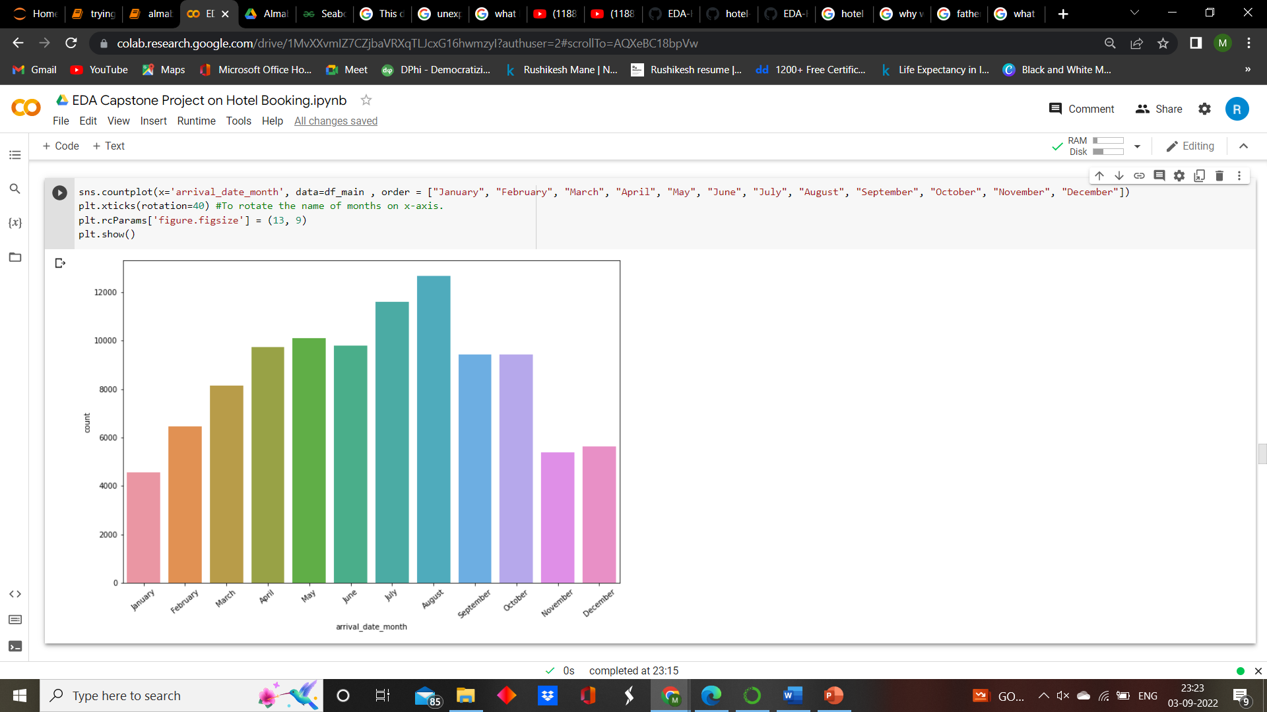
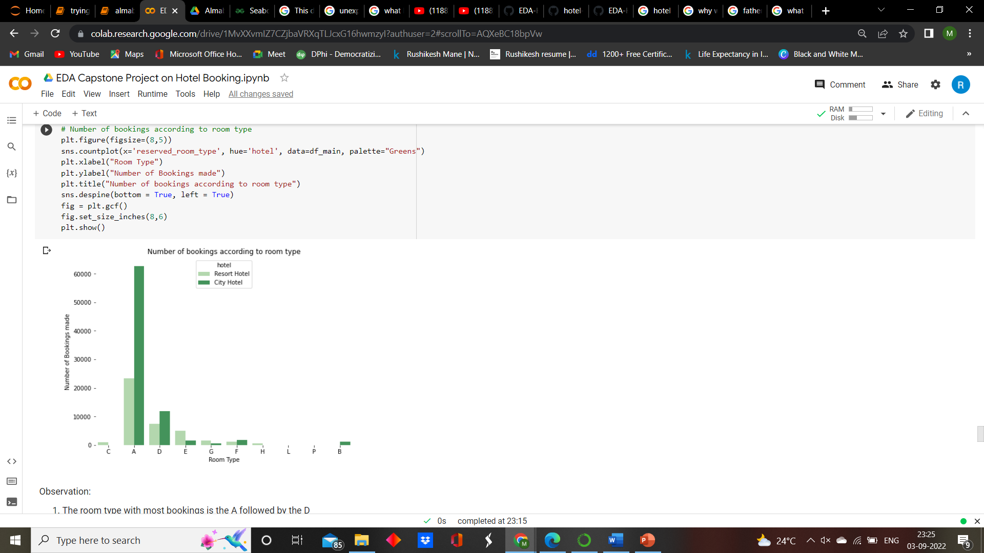
To know the count the visitors in each month and preferred type of hotel rooms,
Observations:
Form the above we can see that the more number guest are coming in the month of August and less number guest comes in January over the year.
Form the second graph we see most of the guest preferred type A rooms for staying in both Resort and City hotel. So hotel should more focusing on how to maximize the number of that type.

Slide 17
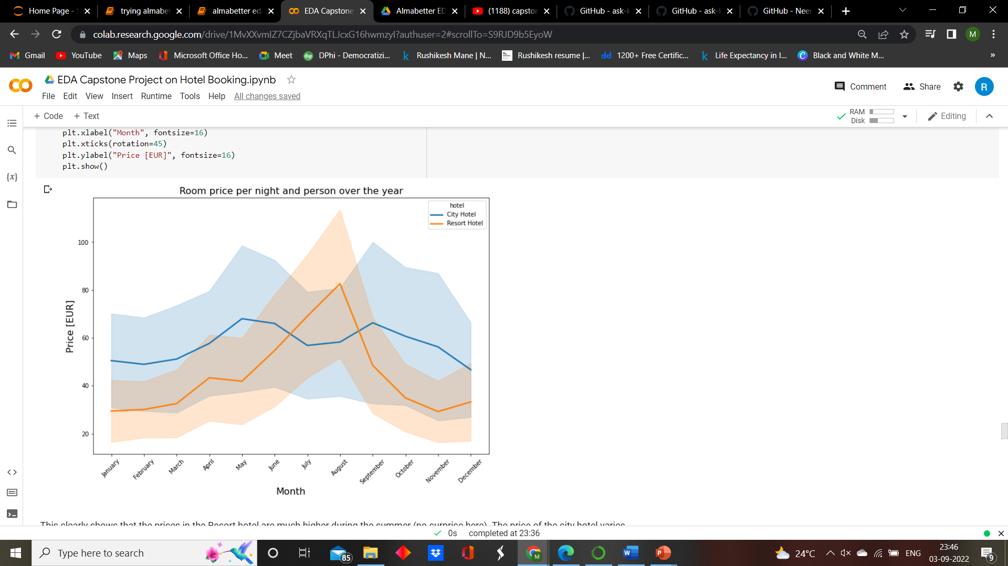
How does the price per night vary over the year?
Observation:
There is a peak on the prices for the Resort hotel is between July and August.
There is a peak on the prices for the City hotel is on May and mid September

Slide 18
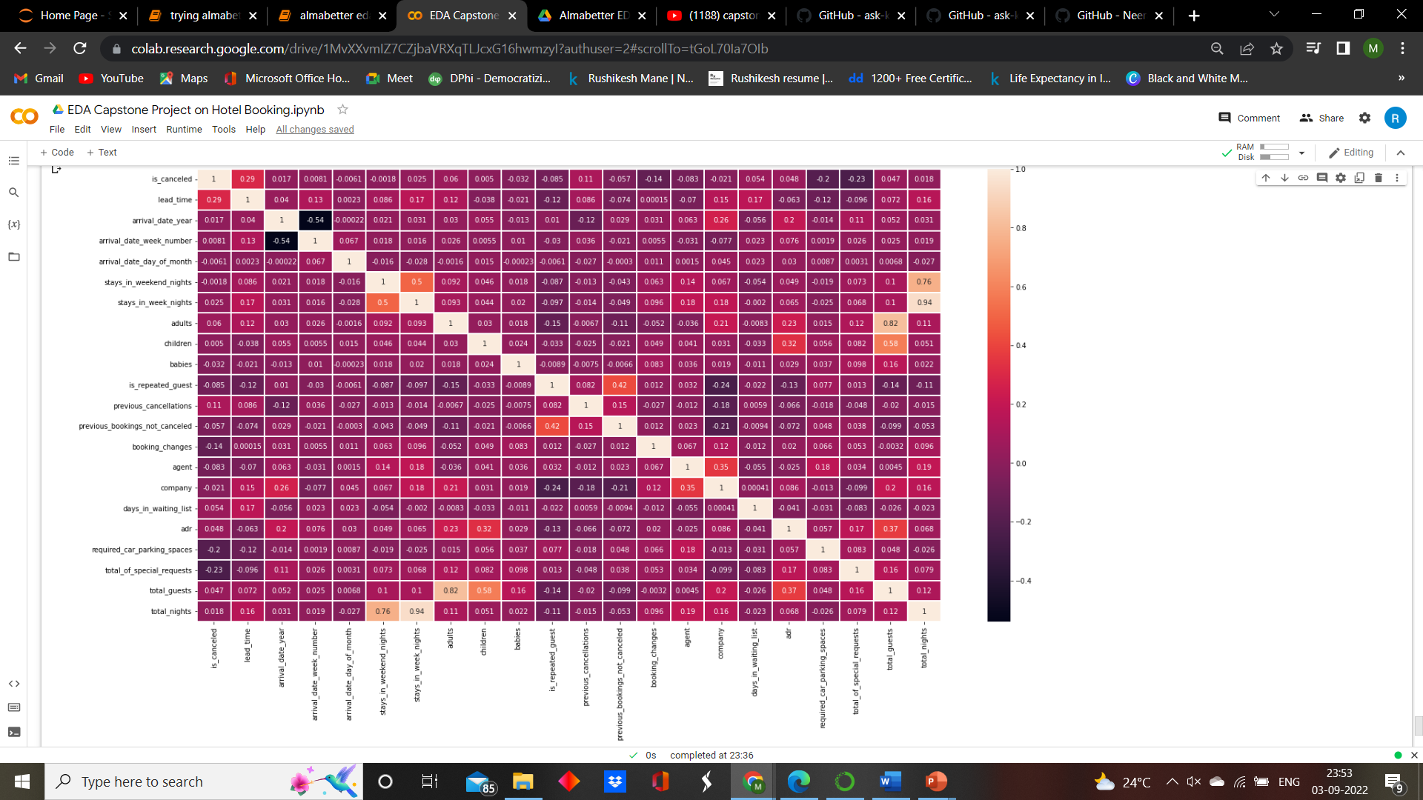
To know the relation between different variables,
Conclusion:
The canceled and same_room_allotted_or_not are negatively correlated. Not getting the same room as per reversed room is not the reason for booking cancellations.
Lead_time and total stay is positively correlated means more is the stay of customer more will be the lead time.
ADR and total people are highly correlated. That means more the people more will be adr. High adr means high revenue.
The is_repeated_guest and previous_bookings_Not_canceled has strong correlation. May be repeated guest are more likely to cancel their bookings.

Slide 19
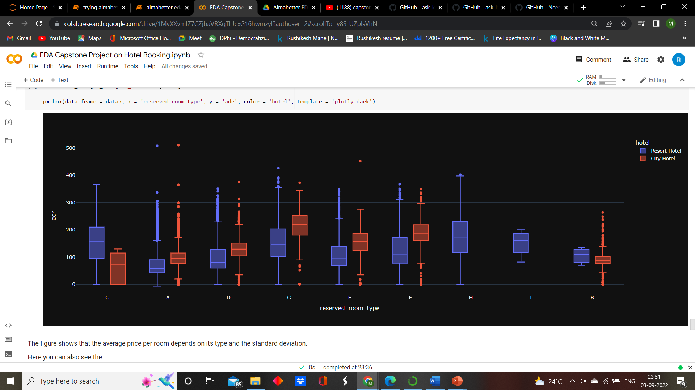
Both hotels have different room types and different meal arrangements. Seasonal factors are also important, So the prices varies a lot. so we are going to create boxplot for better understanding of this.
Conclusion: The figure shows that the average price per room depends on its type and the standard deviation.
And here we can see some outlier of our data.

Slide 20
Overall Conclusions:
City hotels are the most preferred hotel type by the guests. We can say City hotel is the busiest hotel.
27.5 % bookings were got cancelled out of all the bookings.
79.1 % bookings were made through TA/TO (travel agents/Tour operators).
BB( Bed & Breakfast) is the most preferred type of meal by the guests.
Maximum number of guests were from Portugal, i.e. more than 25000 guests.
Most of the bookings for City hotels and Resort hotel were happened in 2016.
Average ADR for city hotel is high as compared to resort hotels. These City hotels are generating more revenue than the resort hotels.
Booking cancellation rate is high for City hotels which almost 30 %.
Average lead time for resort hotel is high.

Slide 21
Resort hotels have the most repeated guests.
Optimal stay in both the type hotel is less than 7 days. Usually people stay for a week.
Almost 19 % people did not cancel their bookings even after not getting the same room which they reserved while booking hotel. Only 2.5 % people cancelled the booking.

